Slide 1


Ben Lehmann
8/6/2023

Slide 2

Outline
Executive Summary
Introduction
Methodology
Results
Conclusion
Appendix

Slide 3
Executive Summary
We collect data using the SpaceX Rest API and use Web Scraping methods using BeautifulSoup4. We will wrangle data to create 1/0 or Success/Failure variables for the data. We will explore the data using Seaborn, Dash, and Plotly for visualization and SQL for statistical calculations and filtering. After this, we will create ML models (KNN,Decision Tree, Logistic Regression, SVM) to find which one is best for prediction of launch.
Results
We found out that ES-L1, GEO, HEO, and SSO have 100% success rate. KSC LC-39A is the best booster, with the best success rate. We also learned with visualization is that the more weight could mean that the launches would be more successful.

Slide 4
Introduction
SpaceX is the leading company in the space industry, with the goal to make space travel available to anyone. SpaceX’s Falcon 9 is one the most used type of rocket. In this Final Project, I will be working with SpaceX and will be working to predict if the first stage will land. This will help the company in terms of determining the cost of each launch.
There are some problems that we need to ask
Do factors such as Launch Site, Number of flights, Orbits make an impact success in first stage launches
Can we find the accuracy of a landing?
Can we find the best ML model for predicting a successful landing

Slide 5

Section 1

Slide 6
Methodology
Data collection methodology:
Data was collected using SpaceX’s Rest API and Web Scraping
Perform data wrangling
Filling in missing data (NAN, Null), Filtering and Label Encoding
Perform exploratory data analysis (EDA) using visualization and SQL
Perform interactive visual analytics using Folium and Plotly and Dash
Perform predictive analysis using classification models
How to build, tune, evaluate classification models (F1, Accuracy)

Slide 7
Data Collection
Use an API Call to gather the data
Use JSON to convert to a dataframe using Pandas
Update the Data with encoding, filling out null values
We need only the Falcon 9, so filter out the rest of the data
Convert the Data to CSV File

Slide 8
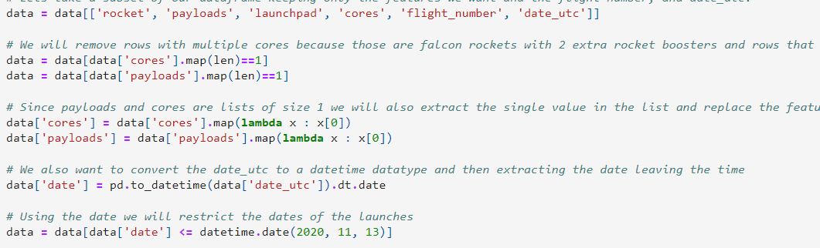
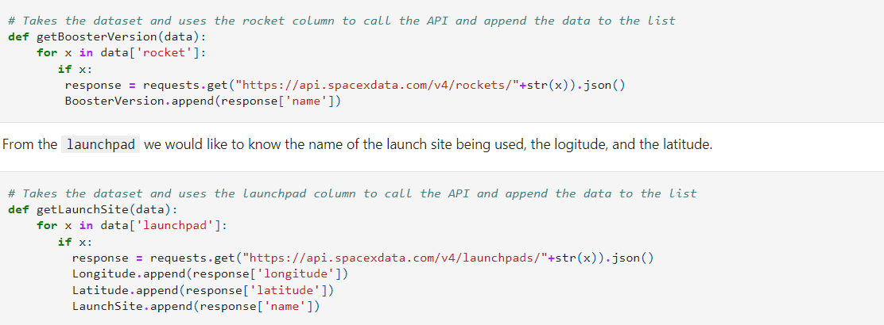
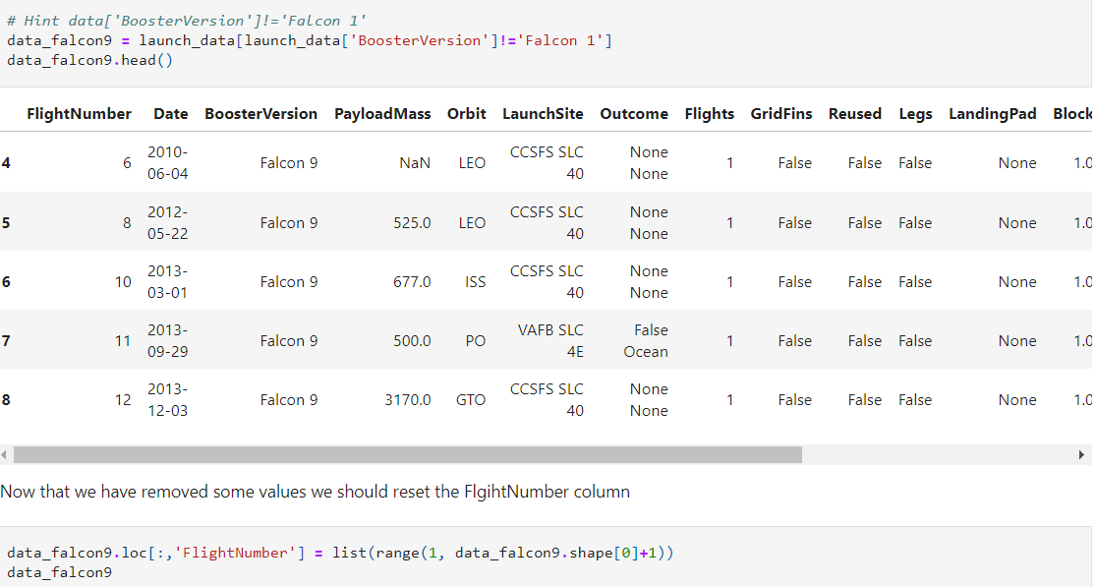
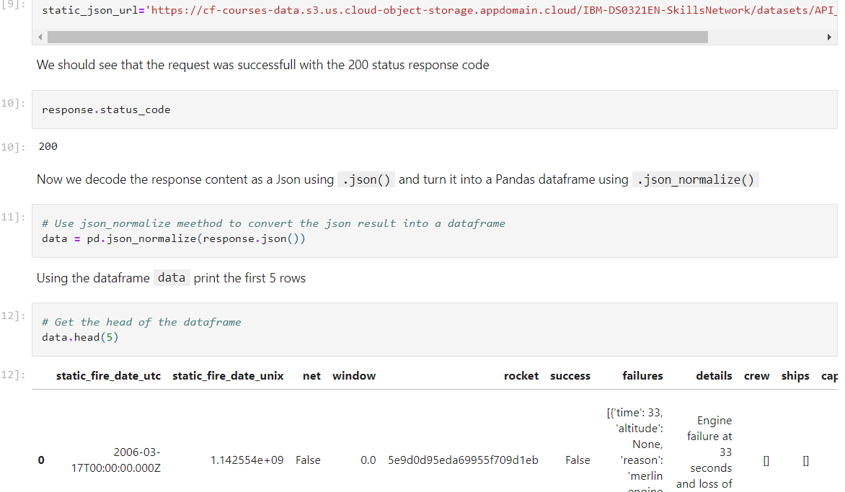
Data Collection – SpaceX API
3. Update Data
4. Get only Falcon 9’s
5. Convert to CSV
https://github.com/BenLehmann12/Capstone-Project/blob/main/jupyter-labs-spacex-data-collection-api.ipynb
1. API Call
2. Convert to JSON

Slide 9
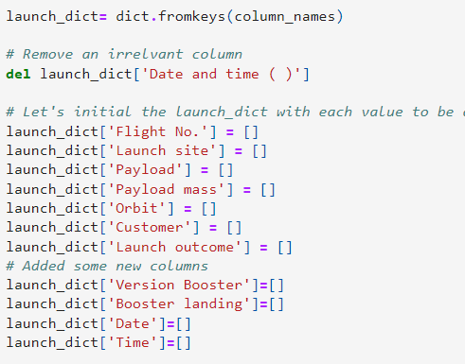
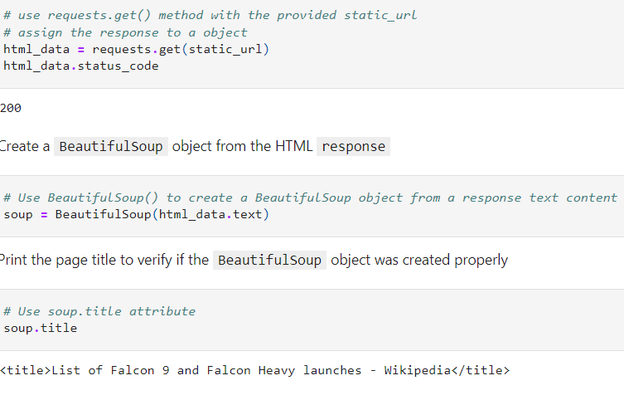
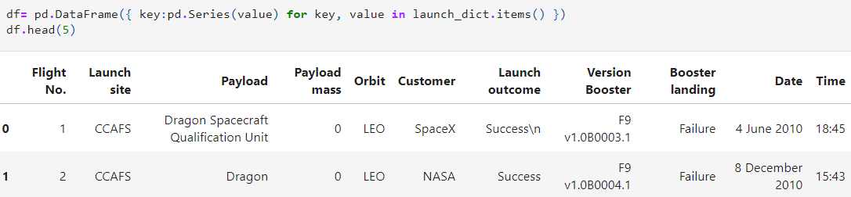
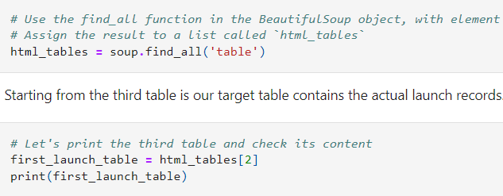
Data Collection - Scraping
3. Storing the Dictionary to parse names
4. Convert to Pandas Data Frame
5. Convert to CSV
https://github.com/BenLehmann12/Capstone-Project/blob/main/jupyter-labs-webscraping.ipynb
Request Web Page and Create BeautifulSoup
Find and Get Column Names

Slide 10
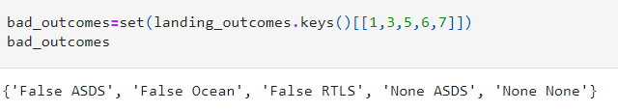
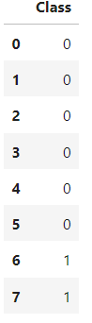
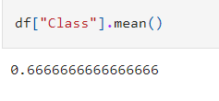
Data Wrangling
Load the Data
Find the Bad Outcomes
Convert to Binary
Find Success Outcome
https://github.com/BenLehmann12/Capstone-Project/blob/main/labs-jupyter-spacex-Data%20wrangling.ipynb

Slide 11
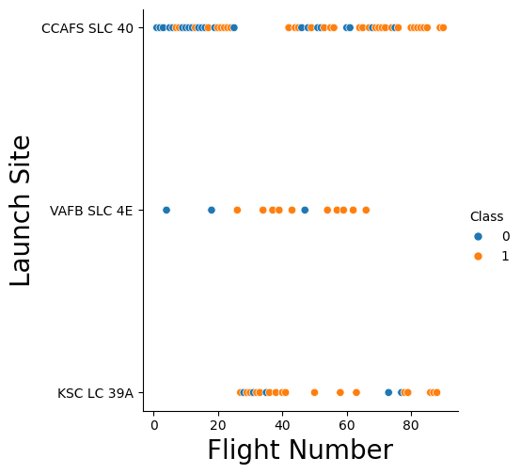
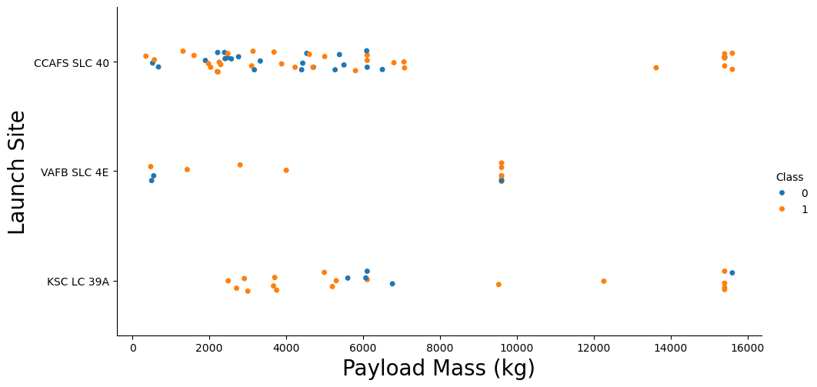
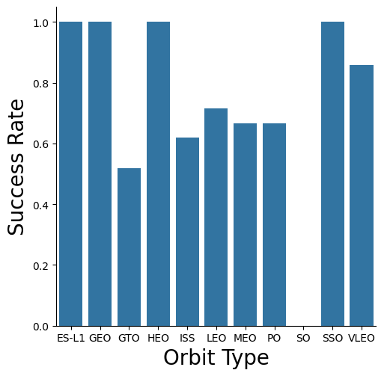
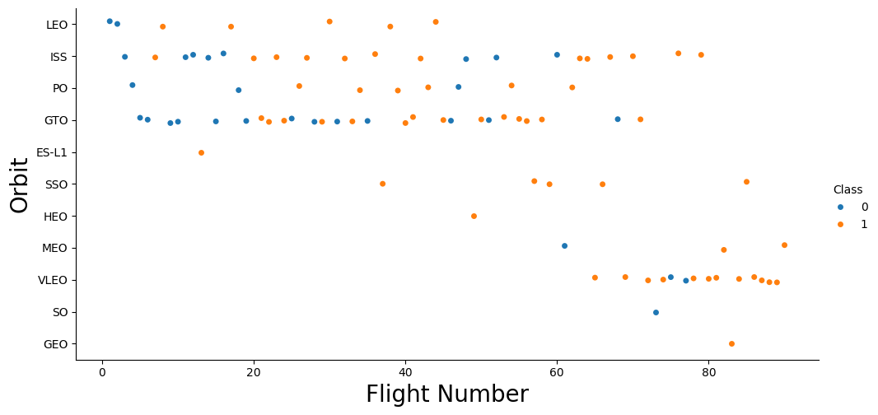
EDA with Data Visualization
https://github.com/BenLehmann12/Capstone-Project/blob/main/edadataviz.ipynb

Slide 12
EDA with SQL
Show the names of the unique launch sites
Show the 5 records where the launch site begins with ‘CAA’
Give the Total Payload Mass Carried by boosters that were launched by NASA
Give the Average Payload Mass Carried by version F9
Find the Data of 1st Successful landing on the pad
Names of boosters which had success landing on drone ship and have payload mass greater than 4,000 but less than 6,000
Total Number of Successful and Failed Missions
Names of Booster versions that have carried max payload
https://github.com/BenLehmann12/Capstone-Project/blob/main/jupyter-labs-eda-sql-coursera_sqllite.ipynb

Slide 13
Build an Interactive Map with Folium
Used Colored Markers to indicate if the launch was a success or a failure
Green means Success and Red means Failure
Used Circles to indicate a Launch Site
Add a blue line to show the Distance between the Site CCAFS SLC40 and the nearest coastline, city or some highway
https://github.com/BenLehmann12/Capstone-Project/blob/main/Site%20Location%20Graphing.ipynb

Slide 14
Build a Dashboard with Plotly Dash
We have a dropdown with a list of Launch Sites
We have Pie Charts showing the proportion of successful launches by each type
A Scatter Plot of Payload mass vs Success rate by Booster type
https://github.com/BenLehmann12/Capstone-Project/blob/main/SpaceXDash.ipynb

Slide 15
Predictive Analysis (Classification)
We Create an Array of Data
Standardize the Data
Split the data with train_test_split
Use GridSearchCV to find the best parameters for Logistic Regression, KNN, Decision Tree, SVM
Get the Accuracy, F1 score
Get the Confusion Matrix
https://github.com/BenLehmann12/Capstone-Project/blob/main/SpaceXMachineLearning.ipynb

Slide 16
Results
When you keep increasing the weight, the success rate increases
KSC LC-39A is the best booster, with the best success rate
ES-L1, GEO, HEO, and SSO have 100% success rate
In terms of ML Model, they all performed nearly the same, but Decision tree was the model to use

Slide 17

Section 2

Slide 18
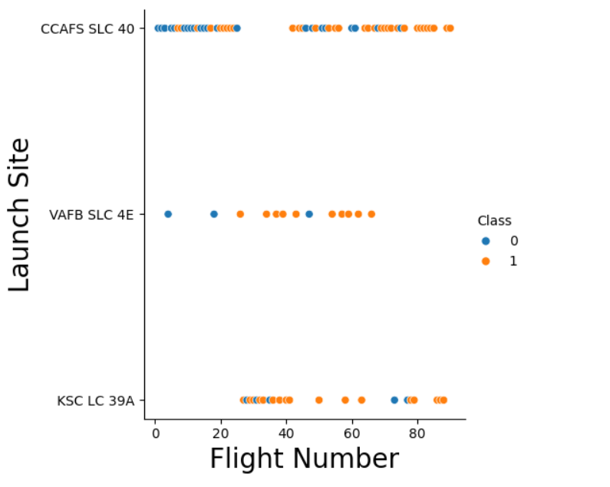
Flight Number vs. Launch Site
There were more failures in the earlier flights, but the success rate improved at the number of flights increased
There were more launches at the CCAFS SLC 40
Blue = 0 = Failure
Orange = 1 = Success

Slide 19
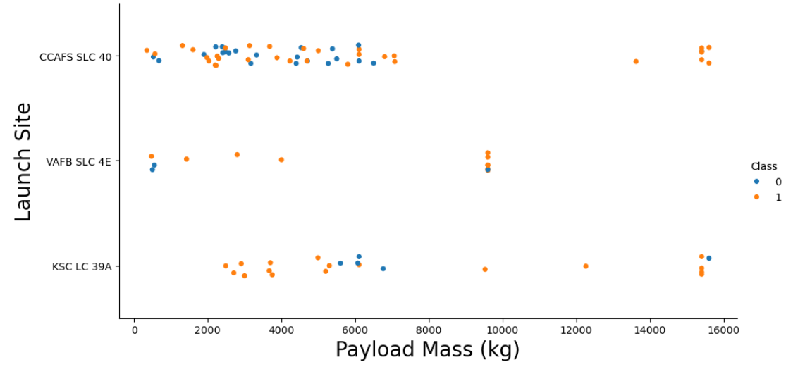
Payload vs. Launch Site
One thing that can be seen is that as the weight increases, we see a higher success rate, so we can say the more weight = more success
Any Payload mass over 8,000 KG would have a much more improved Success Rate

Slide 20
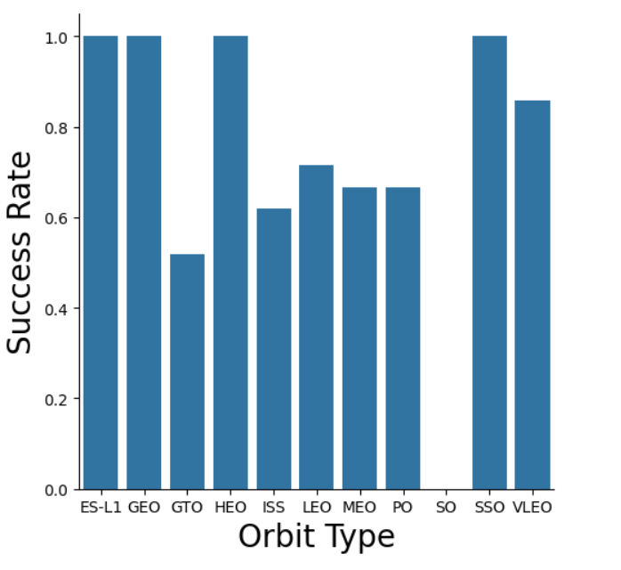
Success Rate vs. Orbit Type
Types ES-L1, GEO,HEO,SSO all had 100% Success Rate
Types GTO, ISS, LEO,MEO,PO all had a range between 40 to 80% of Success Rate
Type SO has 0% Success Rate

Slide 21
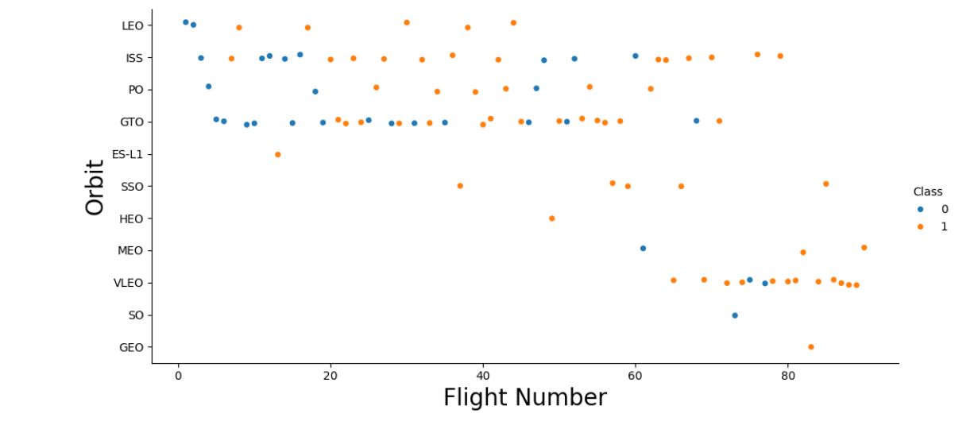
Flight Number vs. Orbit Type
For One Type, LEO, we see failure at the smaller number of flights, but the Success keeps growing at the number of flights increases
The GTO and ISS is a mixed bag, we see failures even in the growing number of flights
We can still say that there is more success in the more number of flights

Slide 22
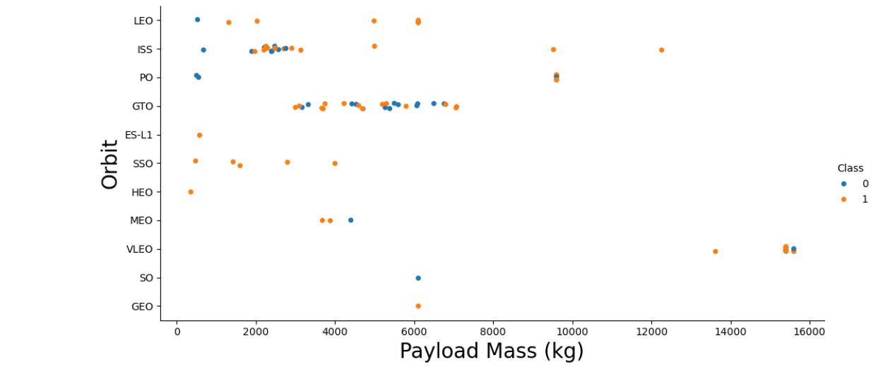
Payload vs. Orbit Type
We can see many of the data points for GTO are more compressed towards each other, so we have a reason to believe that the successes are mixed with payload mass.
ISS did a better job than GTO in terms of Success and Weight.

Slide 23
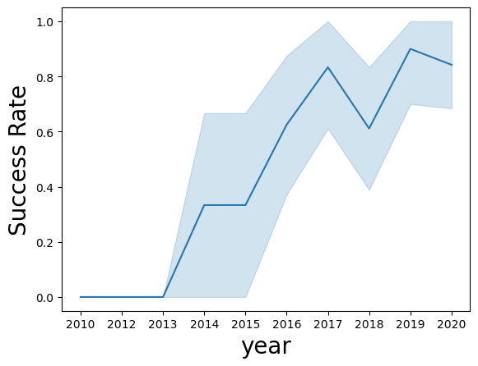
Launch Success Yearly Trend
The Success Rate increases by each year
2017-2018 had a sharp decrease
2018-2019 Had a Jump
2019-2020 went down again

Slide 24
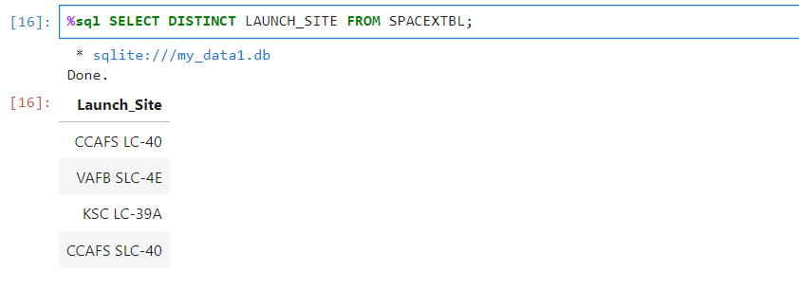
All Launch Site Names
The Unique Sites include CCAFS LC-40, VAFB SLC-4E, KSC LC-39A and CCAFS SLC-40

Slide 25
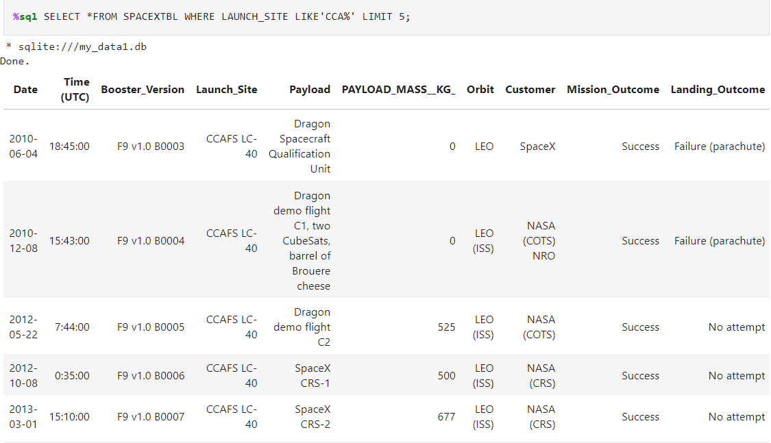
Launch Site Names Begin with 'CCA'
The First Launch Sits Orbit LEO, only 1 is SpaceX and the rest is NASA

Slide 26
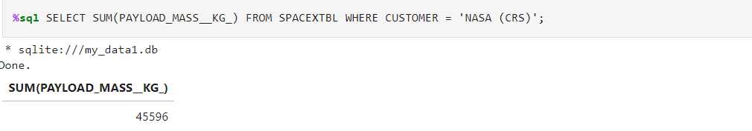
Total Payload Mass
The total Payload is 45596 KG

Slide 27
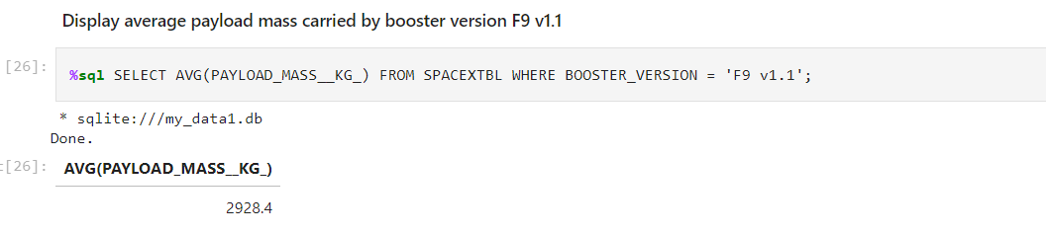
Average Payload Mass by F9 v1.1
The Average Payload Mass Carried is 2928.4 kg

Slide 28
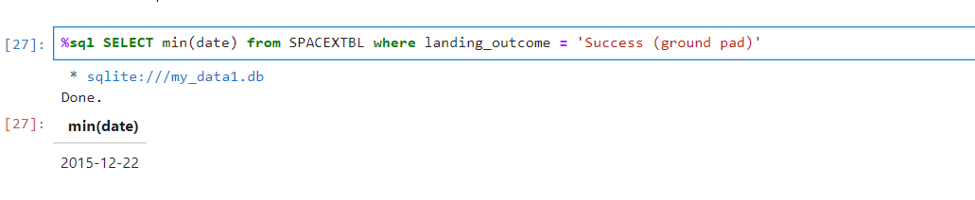
First Successful Ground Landing Date
The First Successful Ground Landing date was on 12/22/2015

Slide 29
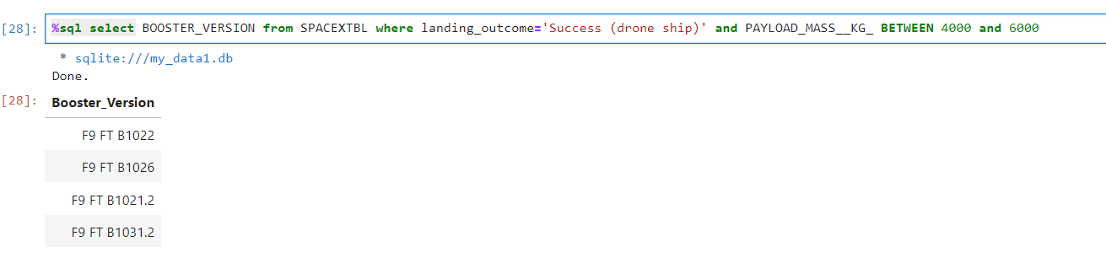
Successful Drone Ship Landing with Payload between 4000 and 6000
There are 5 boosters that ship landing with payload that is between 4000 to 6000 kg

Slide 30
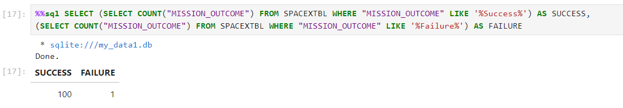
Total Number of Successful and Failure Mission Outcomes
There are 100 success and only 1 failure

Slide 31
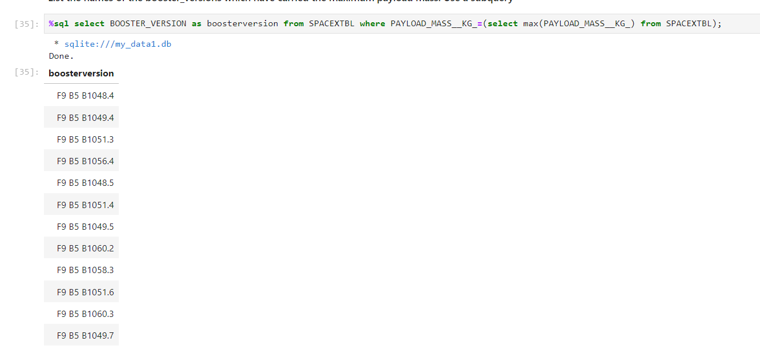
Boosters Carried Maximum Payload
There are 12 boosters with boosters that carried maximum payload.

Slide 32
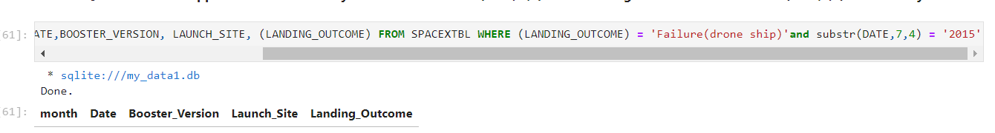
2015 Launch Records
I could not get this one

Slide 33
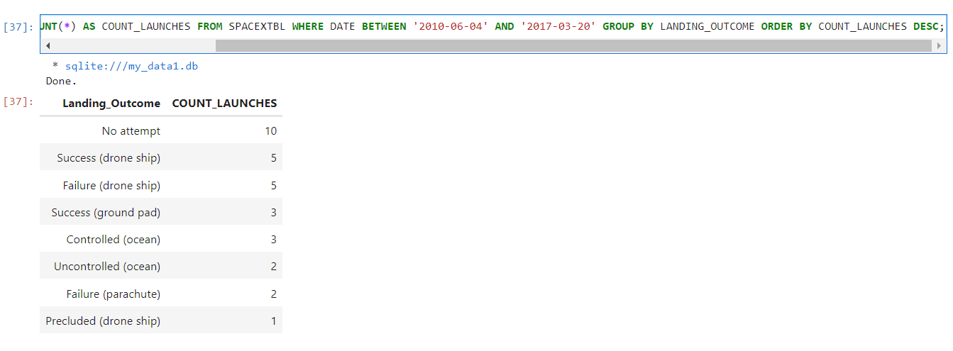
Rank Landing Outcomes Between 2010-06-04 and 2017-03-20
No Attempts had 10 launches while Percludes (Drone Ship) had only 1 Launch

Slide 34

Section 3

Slide 35
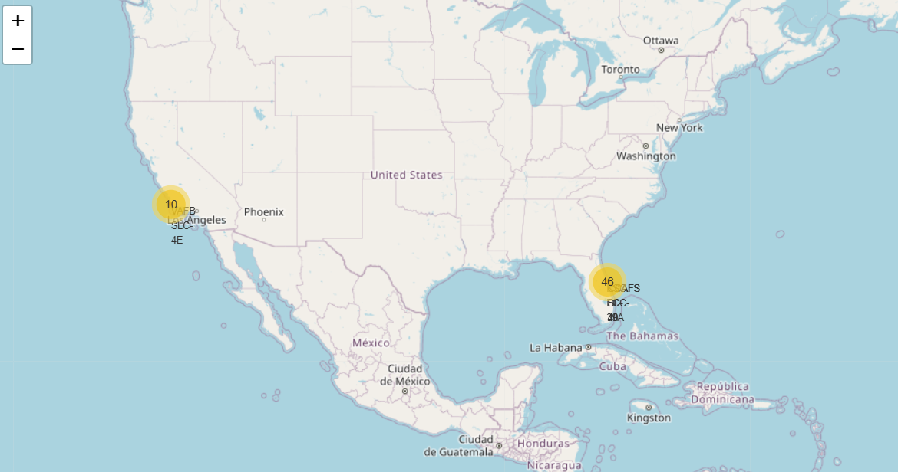
All the Launch Sites
https://github.com/BenLehmann12/Capstone-Project/blob/main/Site%20Location%20Graphing.ipynb
All the launch sites are near the equator, has to do with rotation, so being near the equator is the best for launching

Slide 36
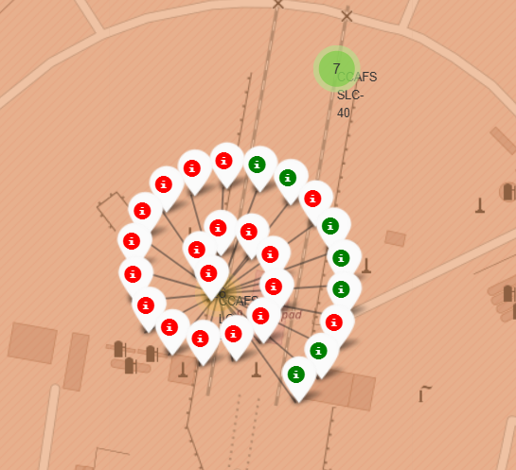
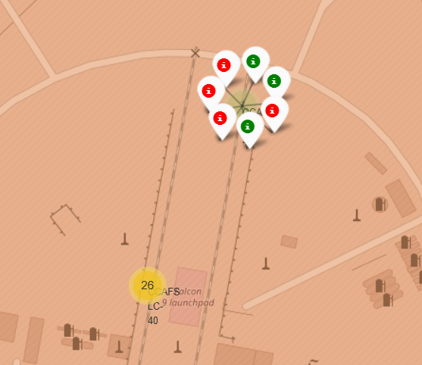
Site Failures and Successes
Green = Success, Red = Failure
In one area of CCAFS SLC-40, there are 7 launches, only 3 are successful
In the other area there are 26, only 7 are successful

Slide 37
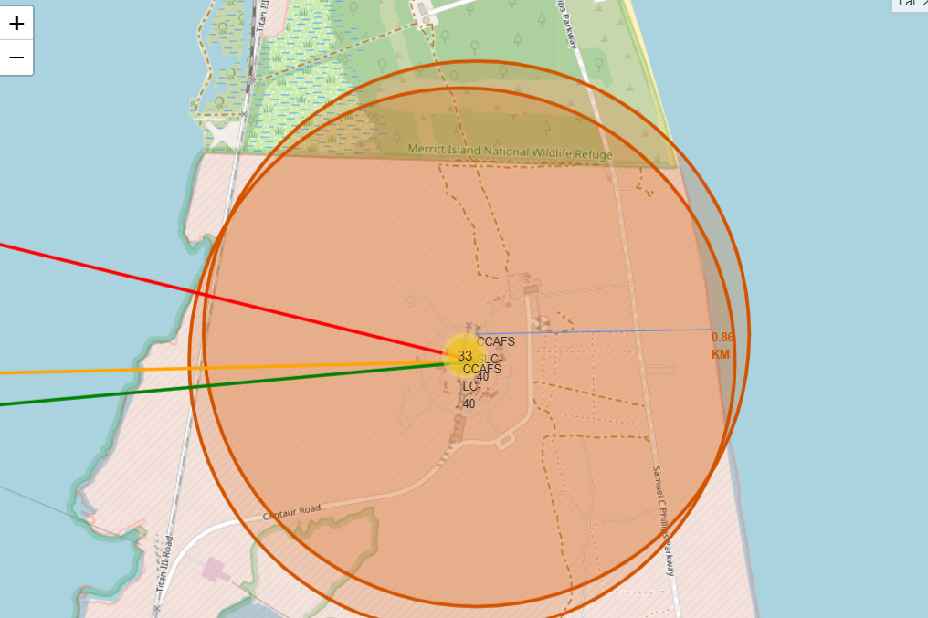
Distances
CCAFS SLC-40
Only 0.86 km to the shoreline
23.23 to the closest city

Slide 38

Section 4

Slide 39
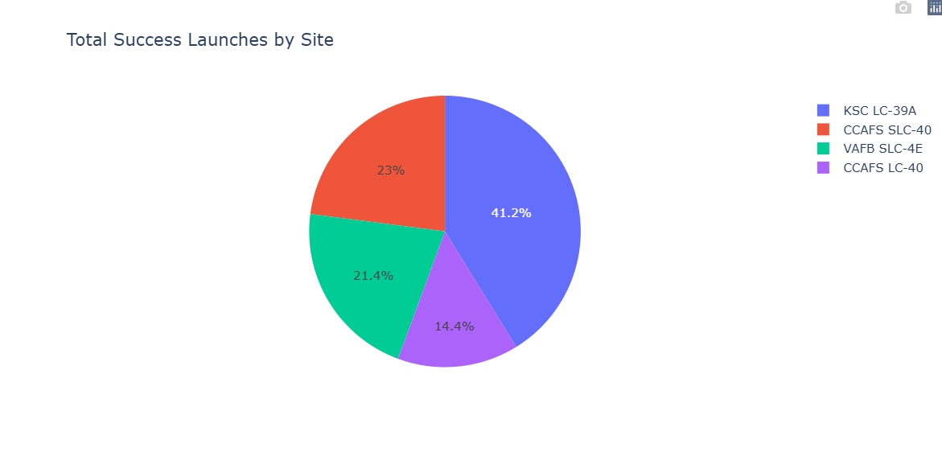
Percentage of Success
https://github.com/BenLehmann12/Capstone-Project/blob/main/SpaceXDash.ipynb
KSC-LC-39A had the best success

Slide 40
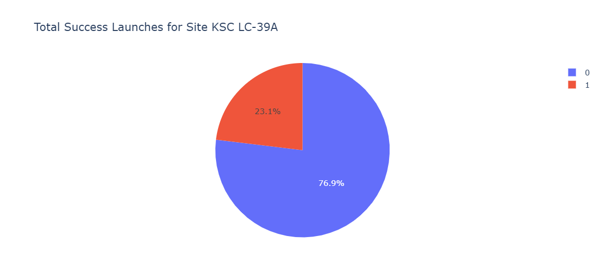
Highest Launch Success
Over 76.9% of KSC LC-39A’s Launches were successful, only 23.1% were Failures

Slide 41
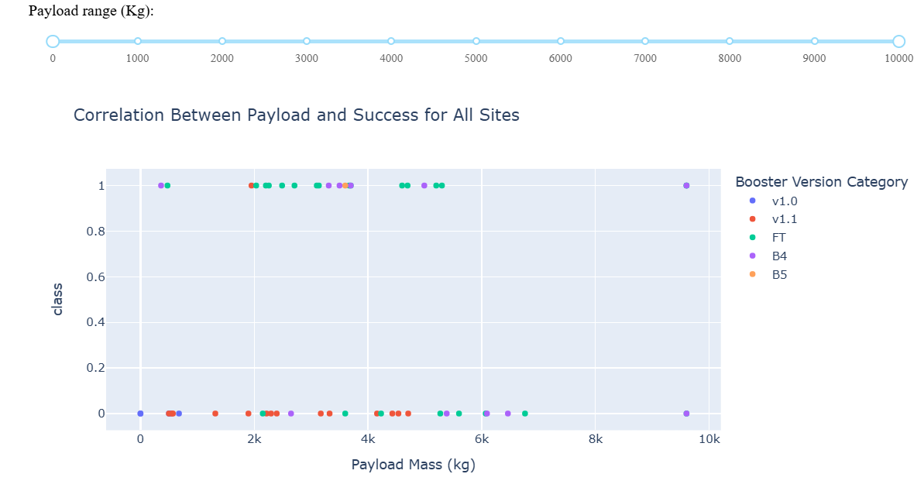
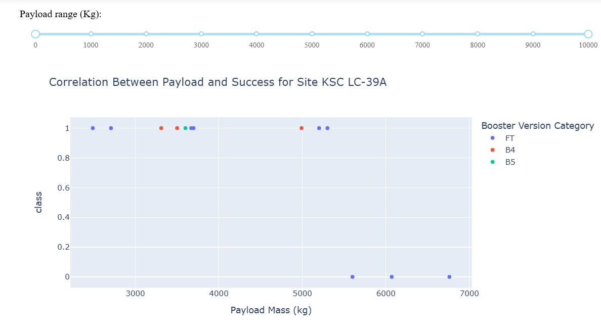
Correlation Payload and Success
Payloads between 2000 to 4000 kg have the best success rate

Slide 42

Section 5

Slide 43
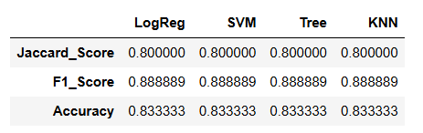
Classification Accuracy
All the Models tended to perform the best. But it could be determined that the Decision tree would be the best model to use.
We can use the .best_score to find the best score of the model

Slide 44
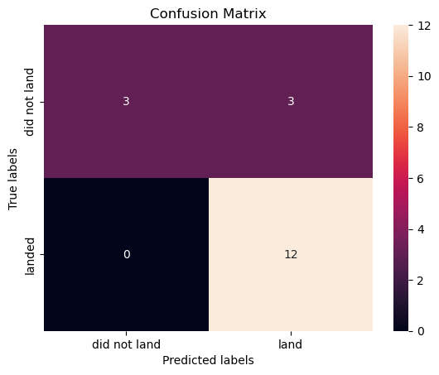
Confusion Matrix
The Confusion Matrix of the Decision Tree
Precision = 80%
Recall = 100%
F1 Score = 89%
Accuracy = 83%

Slide 45
Conclusions
Models: All the Models performed equally, but the Decision Tree is the way to go.
Best Orbits: ES-L1, GEO, HEO, SSO had the best success rate with 100%
Mass: The Larger the Payload Mass, the higher the success rate
Launch: The Success rate for the Launch increased over each time

Slide 46


